Slide 1
Wireless Networks
Lecture 19
cdmaOne/IS-95
1

Slide 2
IS-136
Evolution of AMPS
Based on TDMA
Operates in 800 / 1900 MHz band
TDMA frames of 6 time slots, 40 ms in length
Half rate in 1 slot and double rate in 4 slots
3

Slide 3
IS-136 Channels
Digital Control Channel (DCCH)
Occupies full rate channel (2 time slots)
Divided into logical channels
SMS point-to-point, paging and access response channel (SPACH)
Broadcast control channel (BCCH)
Shared channel feedback (SCF)
Random access control channel
4

Slide 4
Specification summary
Parameter | IS-136 specification
Multiple access | TDMA/FDD
Modulation | /4 DQPSK
Channel bandwidth | 30 kHz
Reverse channel frequency band | 824 – 849 MHz
Forward channel frequency band | 869 – 894 MHz
Forward and reverse channel data rate | 48.6 kb/s
Spectrum efficiency | 1.62 b/s/Hz
Equalizer | unspecified
Channel coding | 16-bit CRC and convolutional coding
Interleaver | Two-slot interleaver
Users per channel | 3 or 6
5

Slide 5
What is CDMA
Both an access method and air-interface
Rest of the network is very similar
Radio resource management, mobility management, security are similar
Power control and handoffs are different
Uses DSSS
Frequency reuse factor is 1
3 systems
IS-95 2G, W-CDMA, and CDMA2000
6

Slide 6
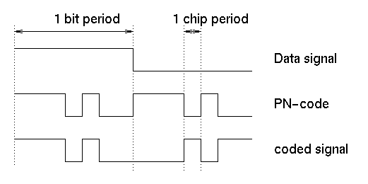
7

Slide 7
Advantages of CDMA Cellular
Higher capacity
Improves voice quality (new coder)
Less power consumption (6-7 mW)
Choice for 3G systems
8

Slide 8
Frequency diversity
frequency-dependent transmission impairments have less effect on signal
Multipath resistance
chipping codes used for CDMA exhibit low cross correlation and low autocorrelation
Privacy
privacy is inherent since spread spectrum is obtained by use of noise-like signals
Graceful degradation
system only gradually degrades as more users access the system
9
Notes:
Privacy:
An important requirement of spreading signals is that they be "noise-like", or pseudorandom. Despreading the signal requires knowledge of the user's code, and for a binary code with spreading factor N there exist 2N possible random sequences.
Graceful Degradation:
In FDMA and TDMA, N channels can be used virtually without interference from other users in the same cell but potential users N+1, N+2, ..., are blocked until a channel is released. The capacity of FDMA and TDMA is therefore fixed at N users and the link quality is determined by the frequency reuse pattern.

Slide 9
Drawbacks of CDMA Cellular
Self-jamming
arriving transmissions from multiple users not aligned on chip boundaries unless users are perfectly synchronized, Produce self-jamming
Near-far problem
signals closer to the receiver are received with less attenuation than signals farther away
Soft handoff
requires that the mobile acquires the new cell before it relinquishes the old; this is more complex than hard handoff used in FDMA and TDMA schemes
Air-interface is the most complex
10
Notes:
Self-Jamming:
Self-interference arises from the presence of delayed replicas of signal due to multipath. The delays cause the spreading sequences of the different users to lose their orthogonality, as by design they are orthogonal only at zero phase offset. Hence in despreading a given user's waveform, nonzero contributions to that user's signal arise from the transmissions of the other users in the network. This is distinct from both TDMA and FDMA, wherein for reasonable time or frequency guardbands, respectively, orthogonality of the received signals can be preserved.
Near-far Problem:
The near-far problem arises from the fact that signals closer to the receiver of interest are received with smaller attenuation than are signals located further away. Therefore the strong signal from the nearby transmitter will mask the weak signal from the remote transmitter. In TDMA and FDMA, this is not a problem since mutual interference can be filtered. In CDMA, however, the near-far effect combined with imperfect orthogonality between codes (e.g. due to different time sifts), leads to substantial interference. Accurate and fast power control appears essential to ensure reliable operation of multi-user DS-CDMA systems.

Slide 10
Mobile Wireless CDMA Design Considerations
RAKE receiver
when multiple versions of a signal arrive more than one chip interval apart, RAKE receiver attempts to recover signals from multiple paths and combine them
This method achieves better performance than simply recovering dominant signal and treating remaining signals as noise
11

Slide 11
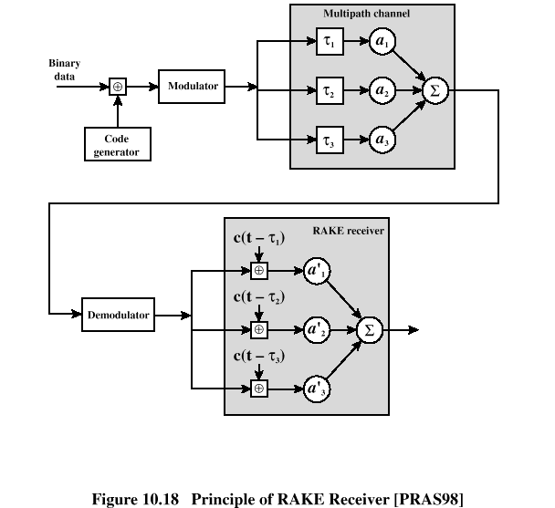
The demodulated chip stream is fed into multiple correlators, each delayed by a different amount. These signals are then combined using weighting factors estimated from the channel
12

Slide 12
IS-95 CDMA Forward Channel
The forward link uses the same frequency spectrum as AMPS (824-849 MHz)
4 types of logical channel:
A pilot,
A synchronization,
7 paging and
55 traffic channels
QPSK is the modulation scheme
Orthogonal Walsh codes are used (64 total)
After orthogonal codes, they are further spread by short PN spreading codes
13

Slide 13
Forward Channels
0
Pilot Channel
1
Paging Channel 1
7
Paging Channel 7
Walsh Codes
8
Traffic Channel 1
9
Traffic Channel 2
31
Traffic Channel 24
32
Sync Channel
33
Traffic Channel 25
63
Traffic Channel 55
14

Slide 14
The pilot channel
Continuous signal on a single channel, allows MS to acquire timing info, provides a phase reference for demodulation process and means for signal strength comparison.
4-6 dB stronger than all other channels
Obtained using all zero Walsh code; i.e., contains no information except the RF carrier
No power control in the pilot channel
15

Slide 15
Sync Channel
Used to acquire initial time synchronization
Synch message includes system ID (SID), network ID (NID), the offset of the PN short code, the state of the PN-long code, and the paging channel data rate (4.8/9.6 Kbps)
Uses W32 for spreading
Operates at 1200 bps
16

Slide 16
Paging Channel
Uses W1-W7
There is no power control
Additionally scrambled by PN long code, which is generated by LFSR of length 42
The rate 4.8 Kbps or 9.6Kbps
17

Slide 17
Traffic Channels
Carry user information
Two possible date rates
RS1={9.6, 4.8, 2.4, 1.2 Kbps}
RS2={14.4, 7.2, 3.6, 1.8 Kbps}
RS1 is mandatory for IS-95, but support for RS2 is optional
Also carry power control bits for the reverse channel
18

Slide 18
Forward Link Transmission
For voice traffic, the speech is encoded at a data rate of 8550 bps
After additional bits added for error detection, it becomes 9600 bps.
The full channel capacity is not used when user is not speaking,
During quiet periods, data rate is upto 1200 bps
2400 bps is used to transmit transients in the background noise
4800 bps is used to mix digitized speech and signaling data
19

Slide 19
Digitized speech is transmitted in 20 ms blocks with FEC rate ½ thus making effective data rate to a max of 19.2 kbps
The resulting stream is XORed with Walsh code generating data at 1.2288 Mbps.
20

Slide 20
21

Slide 21
Summary
IS-136
CDMA/IS-95
Advantages and drwabacks
IS-95 Forward Channels
Pilot Channel
Sync Channel
Paging
Traffic
Next Lecture
22

